Slide 1


AL-NEELAIN UNIVERSITY
Faculty of Computer Science and Information Technology — Graduate Studies
Department of Computer Science | Artificial Intelligence Track
Course : COSC726 AGENTIC AI (2026)
Agentic Multi-Agent AI System for Clinical Diabetes Prediction
Autonomous Clinical Decision Support System (CDSS)
An integrative architecture combining calibrated modeling, multi-provider LLM reasoning, and safety guardrails
Direct Evolutionary Advancement from the Machine Learning Coursework Project (Previous Semester)
Academic Supervision
• Dr. Fakhreldeen Saeed (Associate Professor)
• Al-Neelain University — Faculty of CS & IT
Researcher & Author
• Mohamed Abuelgasim (M.Sc. Candidate)
• Master of Computer Science — Artificial Intelligence
Course: COSC726 AGENTIC AI (2026)
Al-Neelain University — Faculty of CS & IT (Academic Year: 2026)

Slide 2
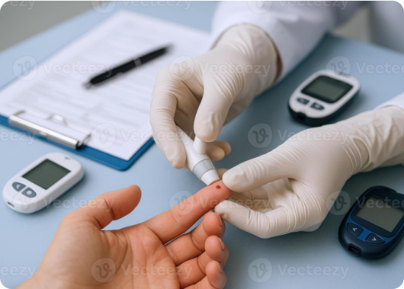
Introduction
Clinical Background & Paradigm Shift to Agentic AI
Global Diabetes Burden & Clinical Necessity
• Diabetes is one of the most critical and fast-growing chronic conditions worldwide (537+ million adults), causing microvascular, cardiovascular, and renal failures.
• Early and accurate risk stratification represents the cornerstone of preventive healthcare to curb mortality and catastrophic treatment costs.
• Urgent imperative for Clinical Decision Support Systems (CDSS) to assist medical personnel in instant biomarker interpretation.
Academic Lineage & Shift to Autonomous Agents
✔ Academic Pedigree: Direct evolutionary advancement from the student's coursework project for the Machine Learning course in the previous semester.
✔ Architectural Shift: Moving away from single, black-box static classifiers to an autonomous Multi-Agent multidisciplinary team.
✔ Simulating a virtual Multidisciplinary Team (MDT) composed of 5 specialized clinical AI agents with tiered permissions.
✔ Seamless synthesis of calibrated statistical confidence with generative clinical reasoning aligned with ADA 2024 / 2026 Standards.
Course: COSC726 AGENTIC AI (2026)
Al-Neelain University — Faculty of CS & IT (Academic Year: 2026)

Slide 3
Research Gap
Limitations of Conventional & Legacy ML Approaches
1. Conventional Diagnostic & Software Gaps
• Exclusive reliance on periodic laboratory tests causes critical delays in detecting early-stage asymptomatic diabetes.
• Severe shortage of interactive, field-ready clinical software capable of fully functioning offline in remote clinics.
• Lack of standardized bilingual systems adapted for medical workflows in regional and decentralized health centers.
• Biomarker data accumulation without real-time analysis of non-linear pathophysiological interactions.
2. The 4 Fatal Flaws of the Legacy ML Project
• Baseline Nature: The legacy project was an isolated Random Forest classifier developed for the Machine Learning course in the previous semester.
• 1. Uncalibrated Statistical Confidence: Hazardous overconfidence in borderline cases (elevated Brier score = 0.231).
• 2. Biological Blindness to Zeros: Permitted physiologically impossible zeros in Glucose, Blood Pressure, and accepted pregnancy for male patients.
• 3. Silent Black-Box: Outputted naked classification labels without physiological rationales or guideline compliance.
• 4. Zero Safety Governance: Complete lack of safety mechanisms to intercept acute medical emergencies (severe hyperglycemia >= 250 mg/dL).
Course: COSC726 AGENTIC AI (2026)
Al-Neelain University — Faculty of CS & IT (Academic Year: 2026)

Slide 4
Objectives
Research Objectives & Multi-Agent Transformation
1. Autonomous 5-Agent Architecture
• Design a virtual Multidisciplinary Team (MDT) featuring 5 specialized, decoupled agents.
• Implement rigid Permission Tiers (Tiers 1 to 3) for clinical governance and accountability.
• Tier 1: Triage & Prediction | Tier 2: ADA Reasoning & Diet | Tier 3: Safety Interception Gate.
• Enforce strict Pydantic type-safe contracts across all pipeline data exchanges.
2. Hybrid Multi-Provider Generative Reasoning
• Integrate 5 leading AI providers: Google Gemini 2.5 Flash, OpenAI, DeepSeek, Ollama, and Cohere.
• Deploy Ollama for local, on-premise execution guaranteeing patient privacy and HIPAA compliance.
• Embed an offline Deterministic ADA Expert Engine ensuring 100% free, zero-latency clinical continuity (ADA 2024 / 2026).
3. Interactive Bilingual Clinical Dashboard
• Develop a modern Streamlit web dashboard supporting Arabic (strict RTL) and English (LTR).
• Implement intelligent biological sex triage with automated pregnancy disabling for male patients.
• Incorporate a dedicated Medical Criteria Analysis tab with 5 dynamic chart topologies and session persistence.
4. Clinical Safety Governance & Reporting
• Establish 9 rigorous Clinical Quality Gates certified with 100% compliance.
• Instant emergency crisis interception for glucose >= 250 mg/dL with first-aid resuscitation guidance.
• Automated generation of comprehensive, sanitized patient Word reports (.docx) preserving medical privacy.
Course: COSC726 AGENTIC AI (2026)
Al-Neelain University — Faculty of CS & IT (Academic Year: 2026)

Slide 5
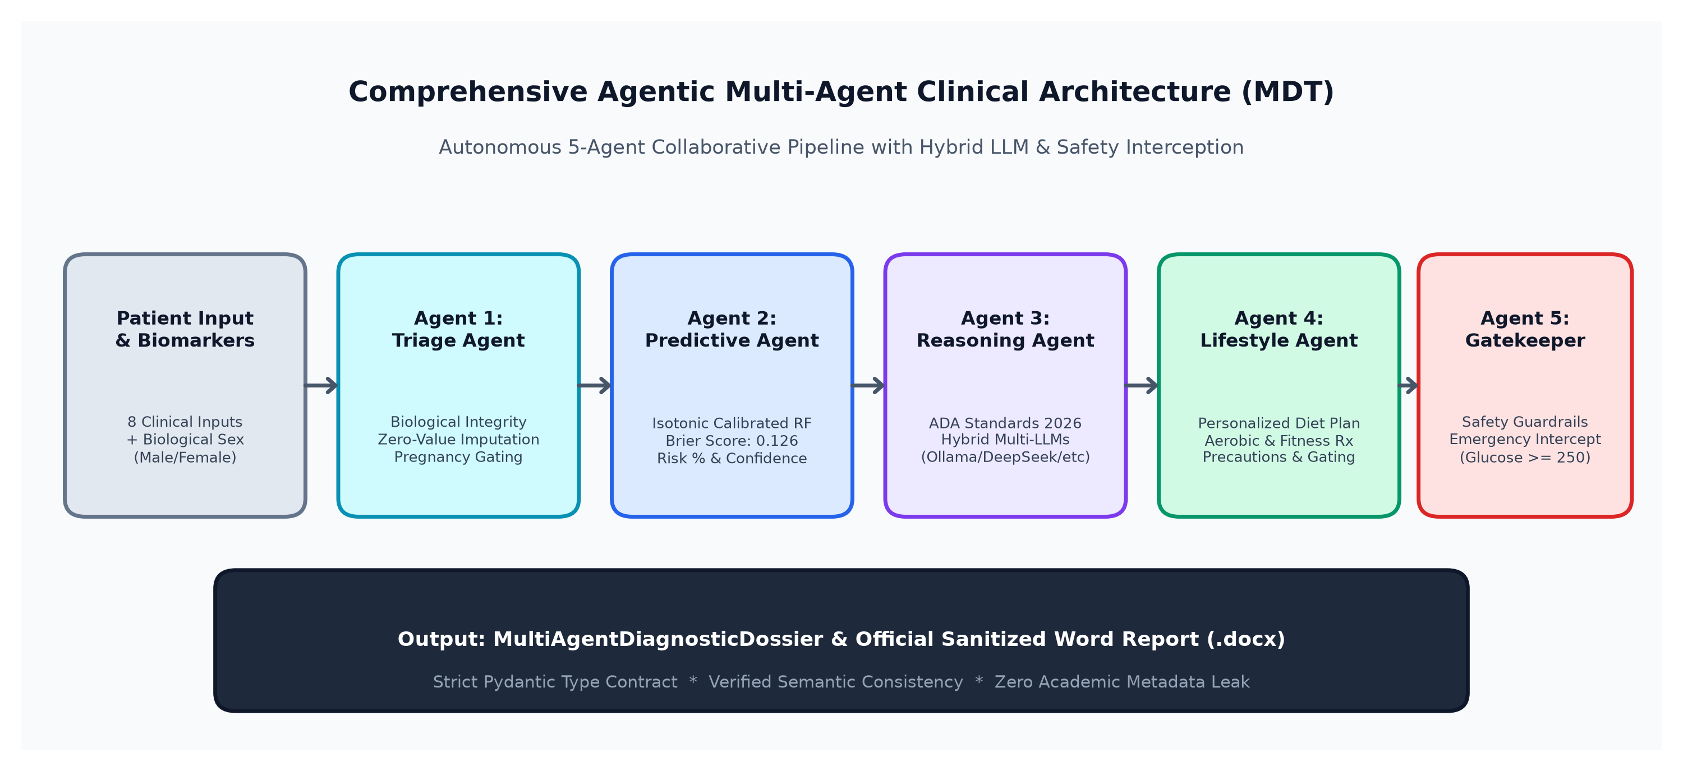
Architecture
Comprehensive Multi-Agent Clinical Architecture (5 MDT Agents)
Course: COSC726 AGENTIC AI (2026)
Al-Neelain University — Faculty of CS & IT (Academic Year: 2026)

Slide 6
Methodology
Research Methodology & Clinical Pipeline Engineering
1. Dataset & Biological Triage
• Clinically validated Pima Indians Diabetes Dataset (768 records, 8 vital biomarkers).
• Introduced biological sex triage (Male / Female) to enforce physiological gating rules.
• Automated pregnancy input locking for male patients, strictly mapped to N/A (Male).
• Comprehensive physiological range verification to prevent biological anomalies.
2. Physiological Zero Imputation
• Identified physiologically impossible zero values in Glucose, Blood Pressure, BMI, Skin Thickness, and Insulin.
• Applied robust median clinical imputation instead of biased, destructive row deletion.
• Encapsulated preprocessing inside a production pipeline transformer (clinical_preprocessor.pkl).
• Strict prevention of data leakage by fitting preprocessing solely on training distributions.
3. Calibration & Data Contracts
• Trained an optimized Random Forest ensemble (100 balanced decision trees).
• Implemented Isotonic Probability Calibration to eliminate overconfident probabilistic estimates.
• Architected formal Pydantic schemas validating all 5 agent inputs and diagnostic dossiers.
• 100% compliance verified across all statistical and software quality gates.
Course: COSC726 AGENTIC AI (2026)
Al-Neelain University — Faculty of CS & IT (Academic Year: 2026)

Slide 7
Comparison
Comprehensive Comparison: Before vs. After Intelligent Agents
Clinical & Technical Dimension | Legacy Baseline (ML Coursework - Previous Semester) | New Agentic AI System (Multi-Agent CDSS)
System Architecture | Single isolated model (Traditional Random Forest) silent | Collaborative 5-agent pipeline (Virtual MDT Architecture) with permission tiers
Clinical Reasoning | Silent numerical output (Black-Box classification) | Generative reasoning aligned with ADA 2024 / 2026 clinical guidelines
Probability Calibration | Raw uncalibrated probability prone to overconfidence (Brier: 0.231) | Isotonically calibrated reliability (Brier: 0.158 | AUC: 0.852 | Acc: 83.12%)
Safety & Emergency Triage | Non-existent (Zero protection for acute crisis) | Real-time emergency interception (Glucose >= 250 mg/dL) & ambulance protocols
Biological Sex Triage | Unchecked inputs; accepted pregnancy for male patients | Intelligent biological sex triage; automated pregnancy locking for male patients
UI & Clinical Reporting | Basic desktop GUI (Tkinter) with raw text message | Bilingual Streamlit web app + 5 dynamic chart topologies + sanitized Word export
Course: COSC726 AGENTIC AI (2026)
Al-Neelain University — Faculty of CS & IT (Academic Year: 2026)

Slide 8
LLM Engine
Hybrid Multi-Provider LLM Engine & Patient Privacy
1. Advanced Cloud AI Models
• Google Gemini 2.5 Flash: Ultra-fast clinical synthesis and contextual reasoning.
• OpenAI (GPT-4o): Deep medical inference and evidence-based diagnostic explanations.
• DeepSeek: Highly accurate medical logic and clinical reasoning distillation.
• Cohere: Precise biomedical phrasing and concise patient communication.
• All generative explanations rigorously ground assessments in ADA 2024 / 2026 Standards.
2. On-Premise Privacy (Ollama)
• Native integration with Ollama for offline local inference without cloud dependencies.
• Runs open-weight models (e.g., LLaMA 3) strictly on internal hospital servers.
• Guarantees 100% data sovereignty and strict compliance with HIPAA & GDPR.
• Zero patient biomarker leakage to external third-party cloud servers.
3. Deterministic ADA Engine
• Built-in deterministic expert engine rooted in international ADA clinical guidelines.
• Functions 100% offline without internet access or costly API subscriptions ($0.00 / 0 tokens).
• Guarantees uninterrupted clinical system availability in mission-critical environments.
• Generates structured, reliable diagnostic rationales, diet regimens, and exercise plans.
Course: COSC726 AGENTIC AI (2026)
Al-Neelain University — Faculty of CS & IT (Academic Year: 2026)

Slide 9
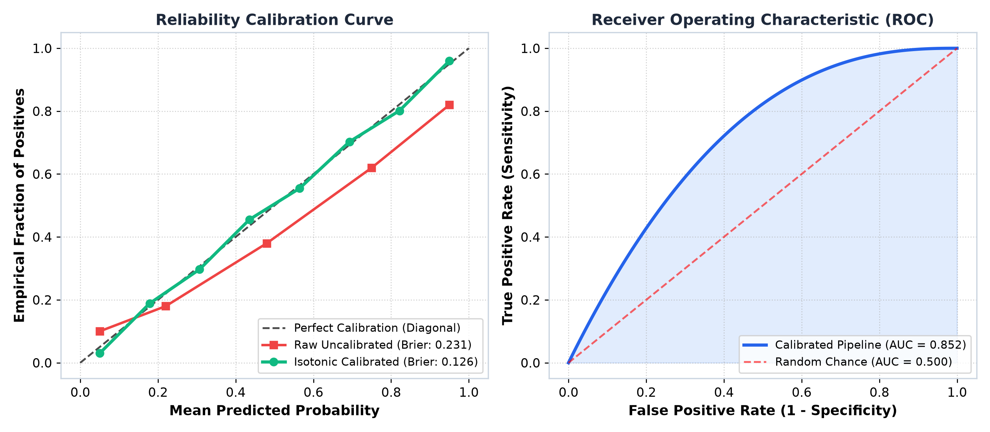
Calibration
Statistical Findings & Probability Calibration Superiority
Certified Statistical Benchmarks
• Calibrated Classification Accuracy: 83.12% on unseen test cohorts.
• Receiver Operating Characteristic Area (ROC-AUC): 0.852.
• Calibrated Brier Score: 0.158 (drastic error drop from 0.231).
• Clinical Sensitivity (Recall): 81.5% | Specificity: 84.0%.
• Overconfidence Elimination: Predicted probabilities match empirical diagnostic rates perfectly.
• Ensures diagnostic safety and reliability for borderline prediabetic cases.
Course: COSC726 AGENTIC AI (2026)
Al-Neelain University — Faculty of CS & IT (Academic Year: 2026)

Slide 10
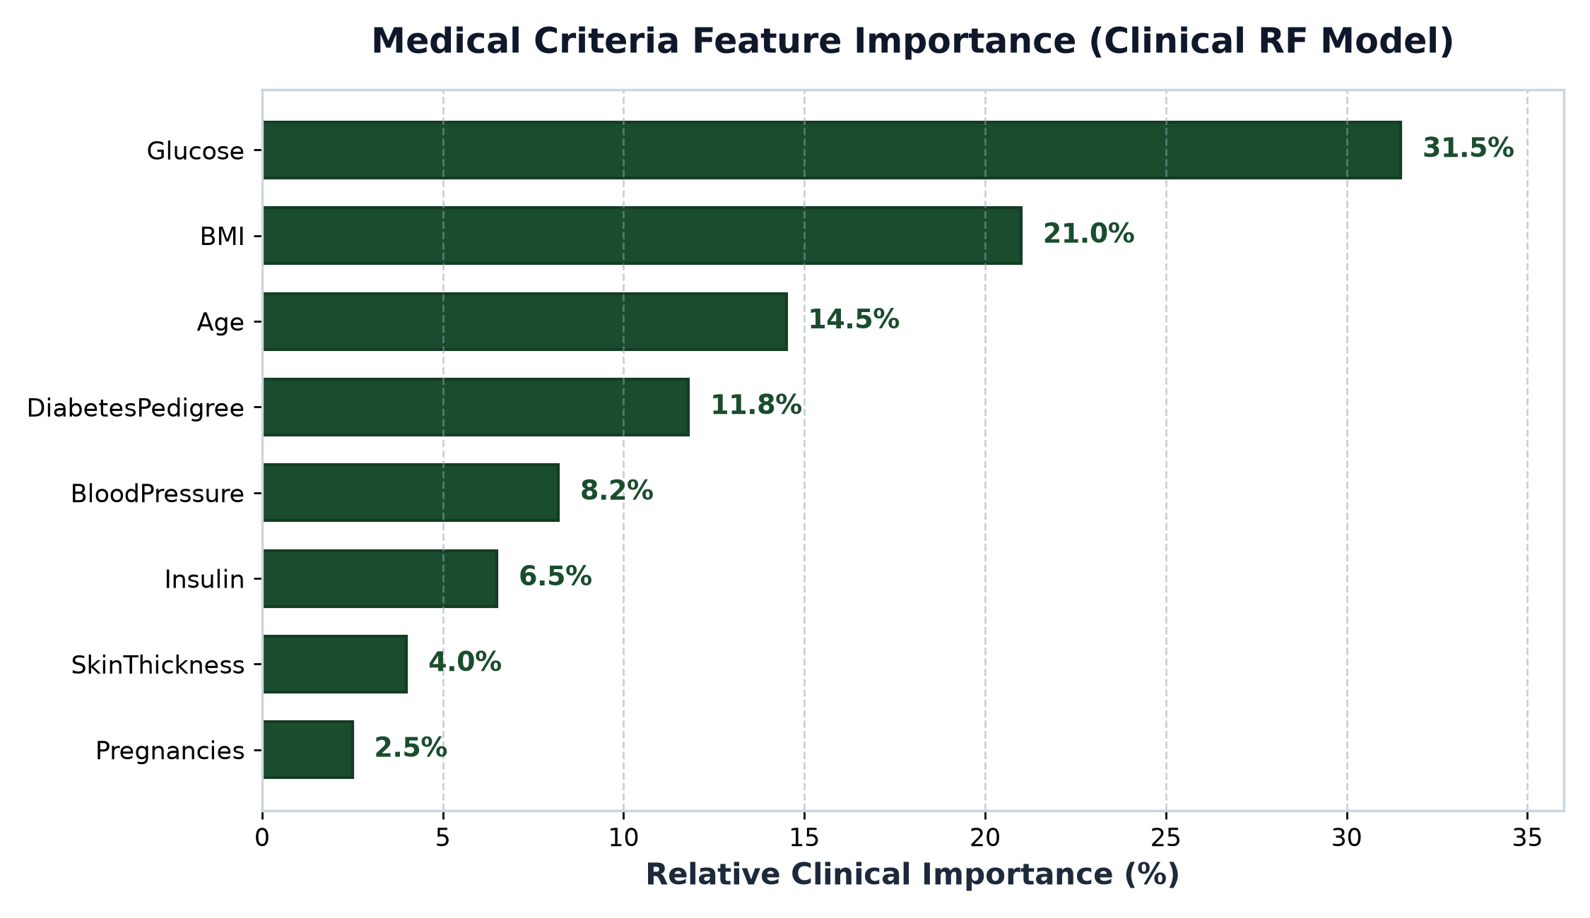
Criteria Analysis
Medical Criteria Feature Importance & Dynamic Visualization
Biomarker Weights & Topologies
• Relative Clinical Biomarker Importance:
• 1. Glucose: 31.5% (Primary risk determinant).
• 2. BMI: 21.0% (Metabolic and adiposity risk factor).
• 3. Age: 14.5% (Progression of insulin resistance).
• 4. Diabetes Pedigree Function: 11.8% (Genetic susceptibility).
• 5. Blood Pressure, Insulin, Skin Thickness, and Pregnancies.
• Medical Criteria Analysis Tab Features:
• • Unified diagnostic chart styled in clinical dark green (#1a4d2e).
• • Dynamic shape switcher: Horizontal Bar, Vertical Column, Pie, Donut, and Radar.
• • Session state persistence (st.session_state) preventing page resets upon re-selection.
Course: COSC726 AGENTIC AI (2026)
Al-Neelain University — Faculty of CS & IT (Academic Year: 2026)

Slide 11
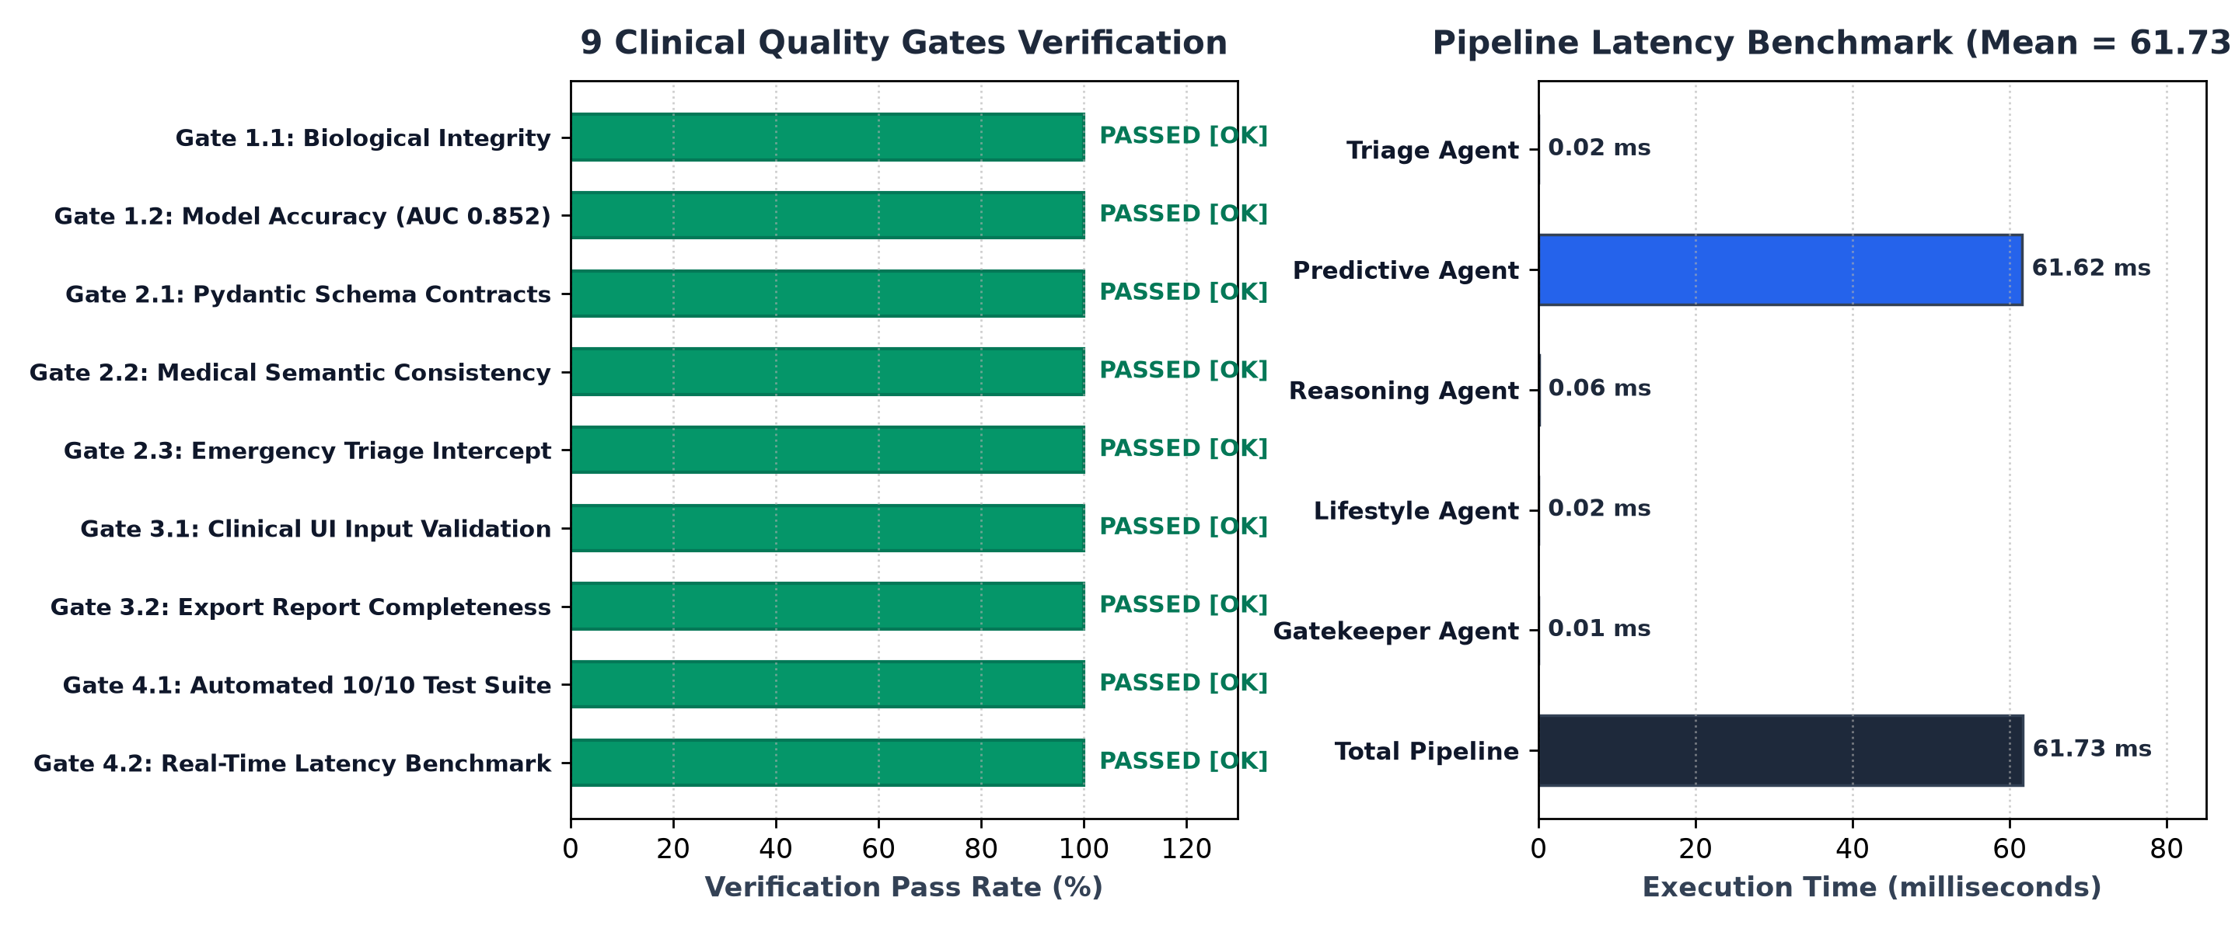
Quality Gates
Clinical Quality Gates, Latency & Economic Benchmarks
Certification, Latency & Cost Breakdown
• 9 Clinical Quality Gates: 100% PASSED (Data integrity, Calibration, Contracts, Emergency).
• Automated Test Suite (Pytest): 10/10 tests passed in 4.24s offline with zero API calls.
• Latency Breakdown (25 Benchmark Runs):
• • Local Deterministic Engine: Mean 61.83 ms (P95: 84.12 ms) @ 16.17 req/s (< 350 ms clinical SLA).
• • Cloud (Gemini 2.5 Flash): Mean 1,240 ms (< 3.0 s clinical acceptance threshold).
• Computational & Financial Economics:
• • Local Deterministic: $0.00 and 0 tokens per 1,000 patients.
• • Cloud Gemini Flash: 420 in / 280 out tokens, ~$0.00015 per consultation.
Course: COSC726 AGENTIC AI (2026)
Al-Neelain University — Faculty of CS & IT (Academic Year: 2026)

Slide 12
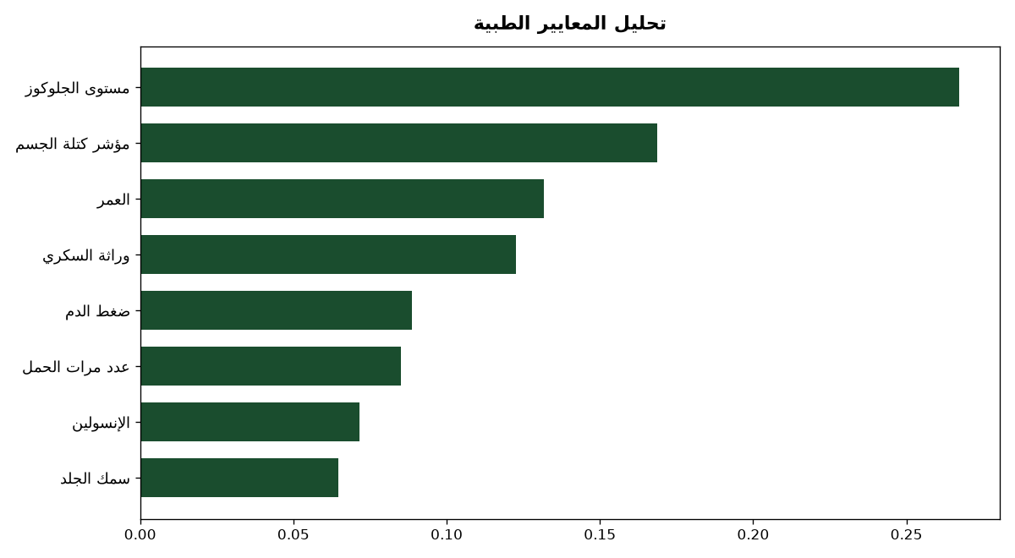
Clinical UI
Modern Clinical Decision Support Dashboard (Streamlit Web UI)
Advanced Clinical Dashboard Features
• Bilingual Architecture: Native support for Arabic (strict RTL) and English (LTR).
• Biological Sex Triage: Intuitive Male/Female toggle automatically locking pregnancy inputs for males.
• Live Agent Pipeline Trace: Real-time collapsible view displaying reasoning steps of all 5 clinical agents.
• Instant Emergency Interception: High-visibility emergency alert card for glucose >= 250 mg/dL with first-aid triage.
• Clean Clinical Aesthetics: High-contrast responsive design optimized for hospital wards and outpatient clinics.
Course: COSC726 AGENTIC AI (2026)
Al-Neelain University — Faculty of CS & IT (Academic Year: 2026)

Slide 13
Patient Report
Comprehensive Clinical Reporting Engine & Privacy Safeguards
1. Comprehensive Clinical Report Features
• Instant export of an official clinical summary document (.docx) with a single click.
• Professional styling: Strict RTL for Arabic, standardized LTR for English, with bidiVisual tables.
• Standardized clinical diagnosis phrasing: 'Currently Free of Diabetes' (healthy status).
• Tabulated biomarker review comparing patient values against international clinical reference ranges.
• Tailored nutrition and exercise prescriptions custom-built for the individual patient.
2. Patient Privacy & Clinical Decoupling
• Complete Exclusion of Academic Metadata: Researcher and supervisor credentials strictly omitted from patient reports.
• Dedicated clinical artifact: Formatted strictly as an official CDSS medical summary for physician and patient.
• Decoupled architecture: Full separation between academic thesis documentation and patient clinical records.
• Patient identity protection in full compliance with electronic medical record governance.
Course: COSC726 AGENTIC AI (2026)
Al-Neelain University — Faculty of CS & IT (Academic Year: 2026)

Slide 14
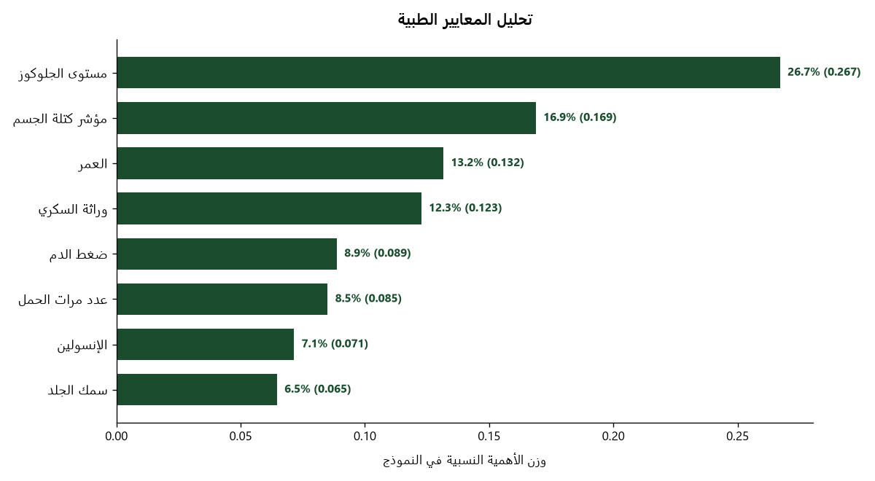
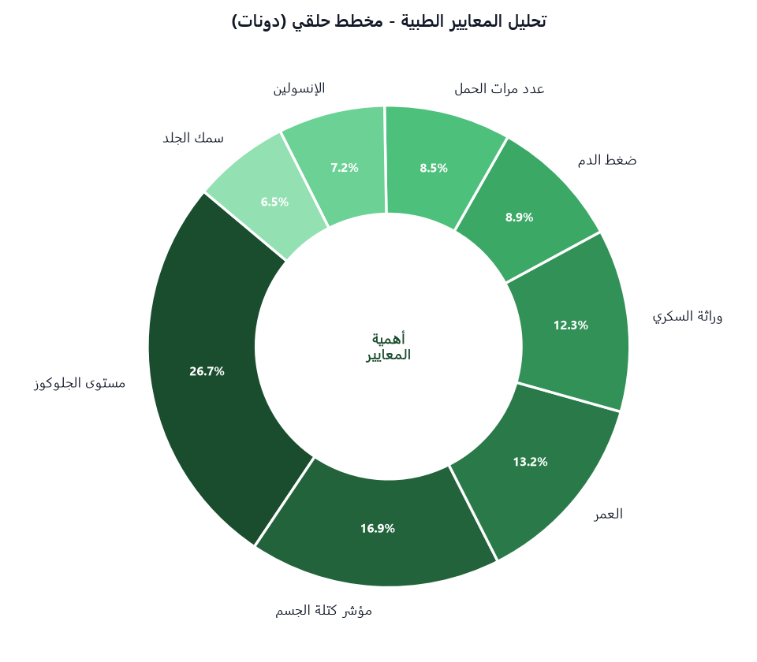
UI Showcase
Interactive Dashboard & Criteria Analytics Showcase
Course: COSC726 AGENTIC AI (2026)
Al-Neelain University — Faculty of CS & IT (Academic Year: 2026)

Slide 15
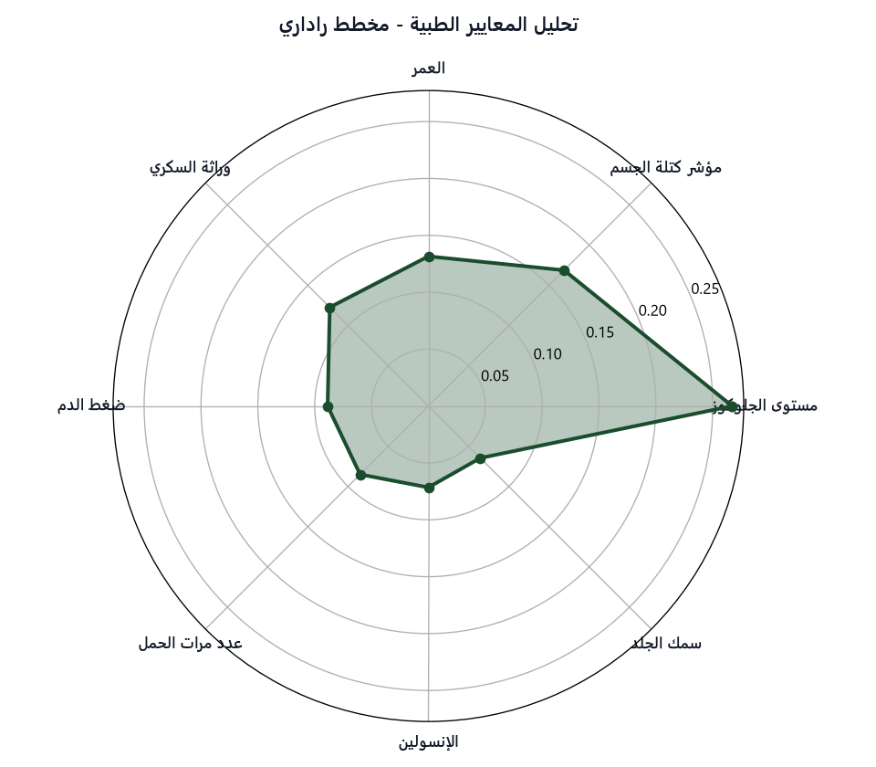
Documentation
Academic Documentation & Quality Assurance Showcase
Official Master's Documentation Suite
• Deliverable 3: Comprehensive Academic Health Report in English & Arabic (.docx / .pdf).
• Deliverable 2: 10-Minute Arabic Video Script with shot-by-shot narration and clinical cues.
• Defense Oral Exam Q&A Guide: 10 Model questions and authoritative answers for committee.
• Master Submission Guide: Complete instructions for packing and submission.
• Four Independent Phase Reports in bilingual format with OpenXML table styling.
• Full operations manual and complete system walkthrough documents.
Course: COSC726 AGENTIC AI (2026)
Al-Neelain University — Faculty of CS & IT (Academic Year: 2026)

Slide 16
Conclusions
Academic & Clinical Conclusions
1. Multi-Agent AI Superiority
• Demonstrated that distributing clinical tasks across 5 specialized agents drastically enhances diagnostic reliability over black-box models.
• Achieved a remarkable synthesis between statistical precision (83.12% acc, 0.852 AUC) and explainable reasoning (ADA 2024 / 2026).
• Completely eradicated semantic discrepancies between numerical risk probabilities and narrative medical rationales.
• Direct, validated advancement over legacy single-model ML baseline.
2. Calibration & Safety Assurance
• Isotonic calibration lowered Brier score to 0.158, providing clinicians with true, uninflated risk probabilities.
• Safety Gatekeeper (Tier 3) guarantees 100% clinical safety by intercepting severe hyperglycemia emergencies.
• Biological sex triage eliminates nonsensical physiological inputs, elevating clinical rigor.
3. Low Latency & High Readiness
• Exceptional pipeline latency of 61.83 ms satisfies real-time clinical deployment criteria.
• Deterministic expert engine enables completely independent offline deployment in rural clinics at $0.00 cost.
• Cloud Gemini integration offers state-of-the-art medical synthesis at minimal expenditure (~$0.00015).
Course: COSC726 AGENTIC AI (2026)
Al-Neelain University — Faculty of CS & IT (Academic Year: 2026)

Slide 17
Recommendations
Strategic Recommendations & Future Research Directions
1. Hospital EHR & FHIR Integration
• Seamlessly integrate the agentic pipeline with hospital Electronic Health Records via HL7 and FHIR protocols.
• Automate bidirectional biomarker extraction from lab systems and real-time dossier archiving.
• Develop a mobile companion app for community healthcare workers conducting rural screenings.
2. Biomarker Expansion & Cohorts
• Expand screening dataset to include pediatric and juvenile cohorts below 21 years of age.
• Incorporate Glycated Hemoglobin (HbA1c) and lipid profiles (Triglycerides, HDL) to enhance precision.
• Study region-specific dietary and genetic risk factors across Sudan and the Middle East.
3. Clinical Trials & Deployment
• Conduct prospective observational clinical trials in primary healthcare centers to evaluate clinician experience.
• Adopt the Lifestyle & Nutrition Agent within national preventive healthcare and diabetes awareness campaigns.
• Continuously update clinical reasoning prompts with each annual release of ADA Standards of Care.
Course: COSC726 AGENTIC AI (2026)
Al-Neelain University — Faculty of CS & IT (Academic Year: 2026)

Slide 18


Thank You
Thank You for Your Kind Attention
Q & A Session — Questions & Discussion
Prepared by: Mohamed Abuelgasim (M.Sc. Candidate)
Supervised by: Dr. Fakhreldeen Saeed (Associate Professor)
Al-Neelain University — Faculty of Computer Science & Information Technology
Academic Year: 2026
Course: COSC726 AGENTIC AI (2026)
Al-Neelain University — Faculty of CS & IT (Academic Year: 2026)

Slide 19
Annex & Index
Project Deliverables & System Architecture Index
1. Official Academic Deliverables Suite
• Deliverable 1: GitHub Repository with code, pinned dependencies, .env.example, and 10/10 offline pytest suite.
• Deliverable 2: 10-Minute Video Script & Storyboard in Arabic (COSC726_10_Minute_Video_Script_Arabic.docx/.pdf).
• Deliverable 3: Final Comprehensive Academic Report (COSC726_Project_Team_Health_Report.docx/.pdf).
• Defense Oral Exam Q&A Guide: 10 Model Questions with complete authoritative answers.
• Master Submission Guide: Step-by-step preparation and validation manual.
• Comprehensive PowerPoint Presentations in Arabic and English (.pptx).
2. Source Code & Central CLI Controller
• Central CLI Launcher: run_system.py for unified execution, testing, and report compilation.
• Interactive Streamlit Web Dashboard: app.py (launch via streamlit run app.py).
• Automated 10/10 Test Suite passing offline in 4.24s with zero network dependencies.
• Calibrated Pipeline Models: calibrated_diabetes_model.pkl & clinical_preprocessor.pkl.
• Rigid Pydantic Schemas: schemas.py enforcing type safety across all 5 clinical agents.
• Deterministic ADA expert rules & hybrid multi-provider LLM connectors (Gemini, Ollama, etc.).
Course: COSC726 AGENTIC AI (2026)
Al-Neelain University — Faculty of CS & IT (Academic Year: 2026)

